Slide 1
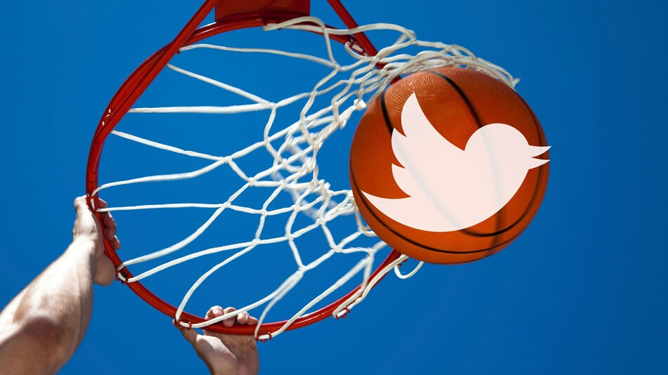
TWITTER ANALYSIS

Slide 2
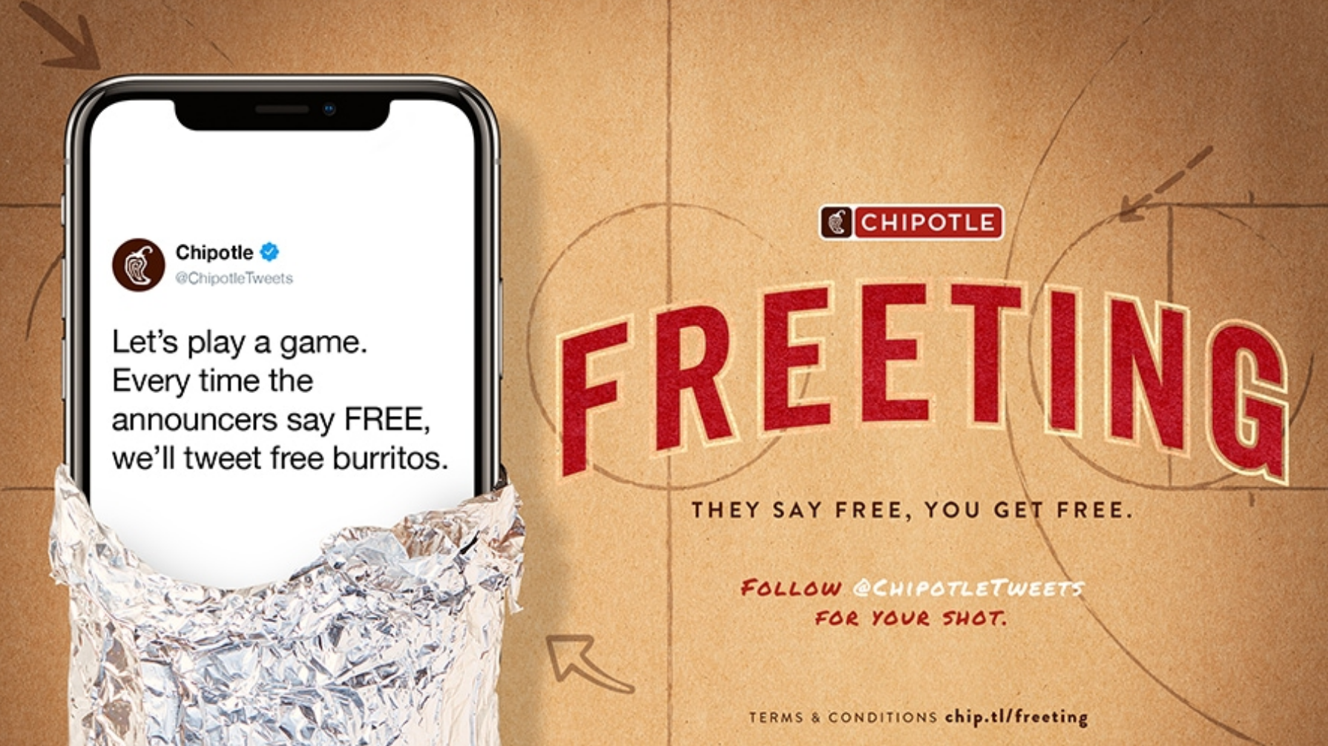

Slide 3

2
B
100%
YOY
+
Impressions

Slide 4
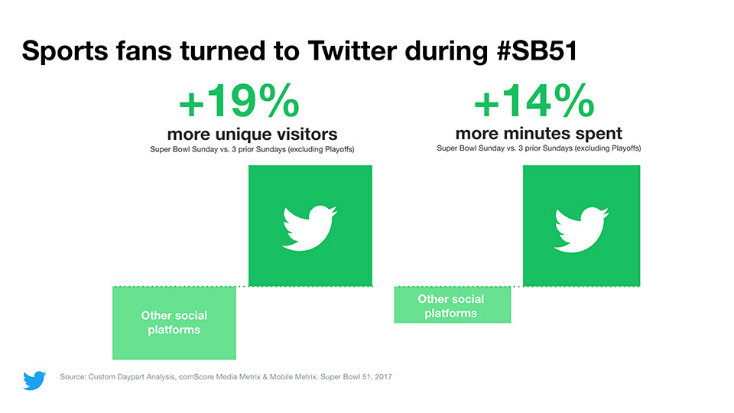


Slide 5

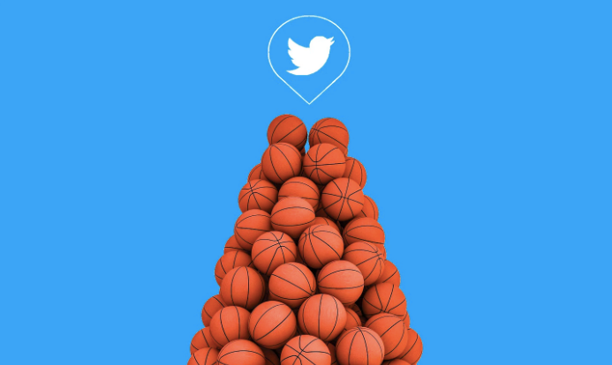
Our Goal
Analyze how NBA Final can have an impact on Twitter communities through a sentiment analysis and a social network analysis

Slide 6

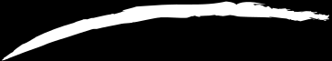
Social Network
Visualization
Social Network
Overview
Sentiment
Analysis
Data
Exploration

Slide 7
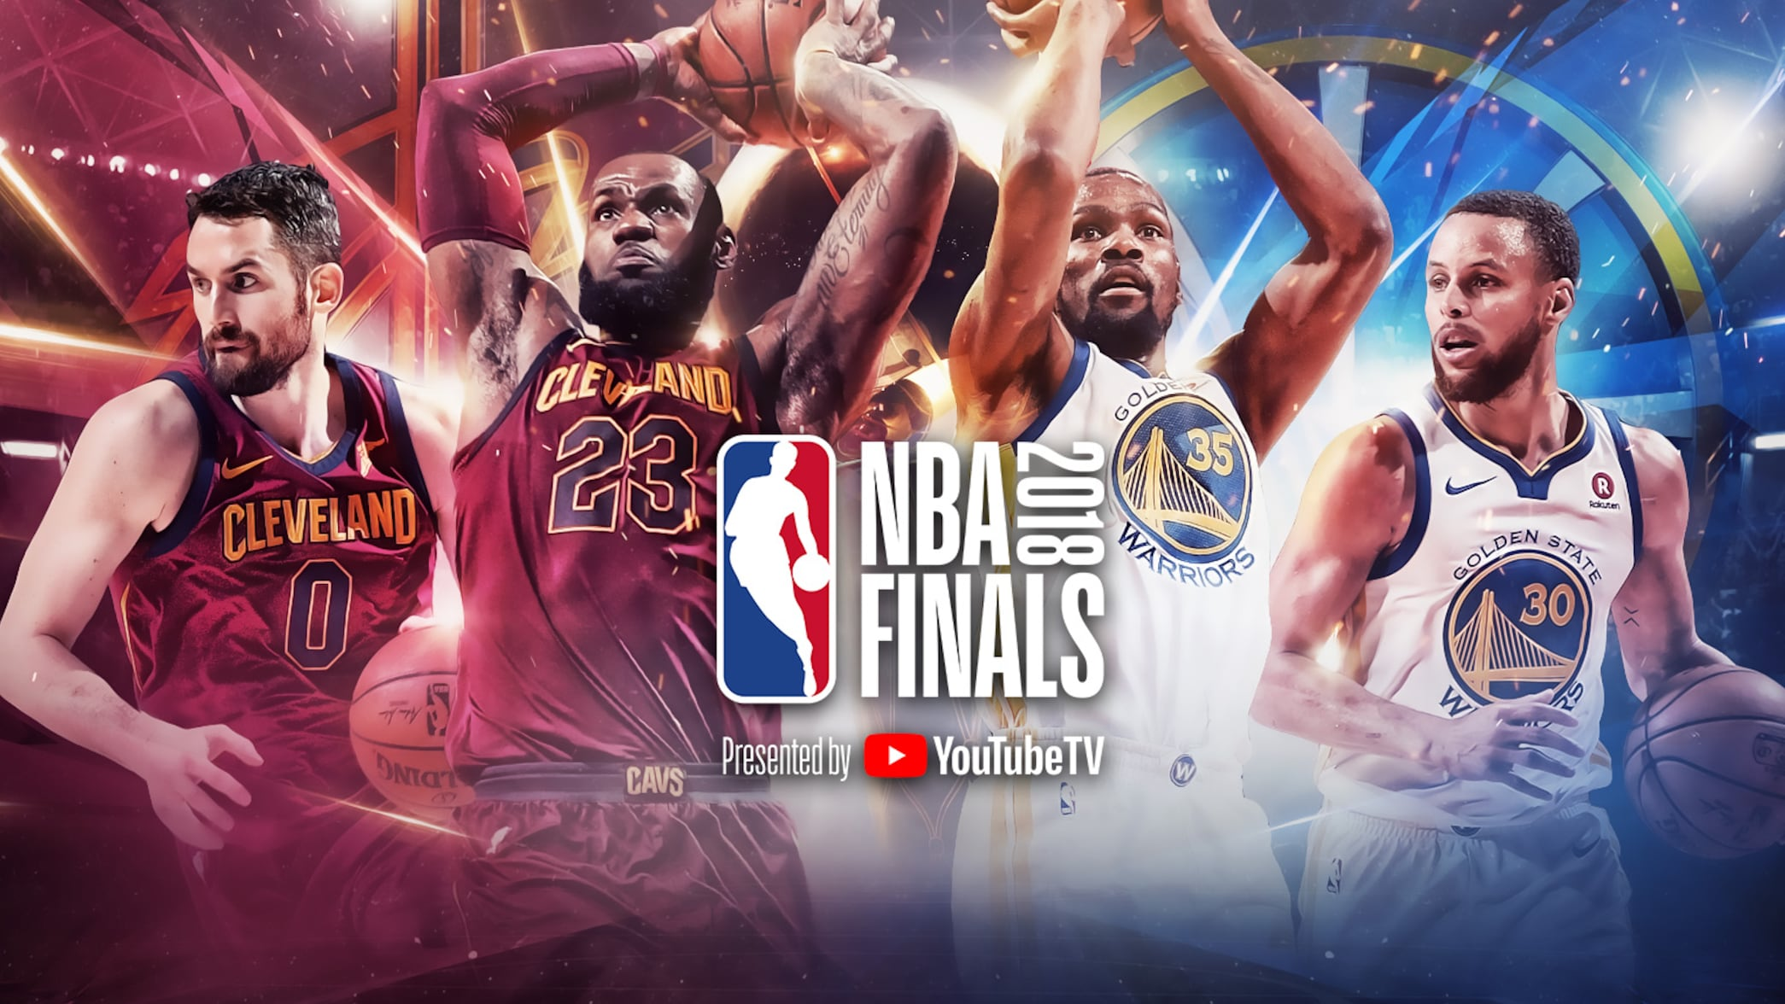

Slide 8

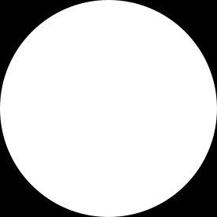

Datasets
Tweets captured during the 3rd game of the 2018 NBA Finals between Cleveland Cavaliers and Golden State Warriors.
The capture started on Thursday, June 7th 01:13 am UCT and finished on Thursday, June 7th 01:58 am UCT
Tweets captured using Twitter's Streaming API, with the keyword #NBAFinals

Slide 9




Data Dictionary
Tweets
id, created_at, and text
NBA
tweets
name, description, followers_count, friends_count, favorites_count, statuses_count
User
User
YS
hashtags, user mentions, links, tweets with attached photos, videos
Entity
Datasets
Latitude
Location
Longitude

Slide 10


Data Exploration

Slide 11
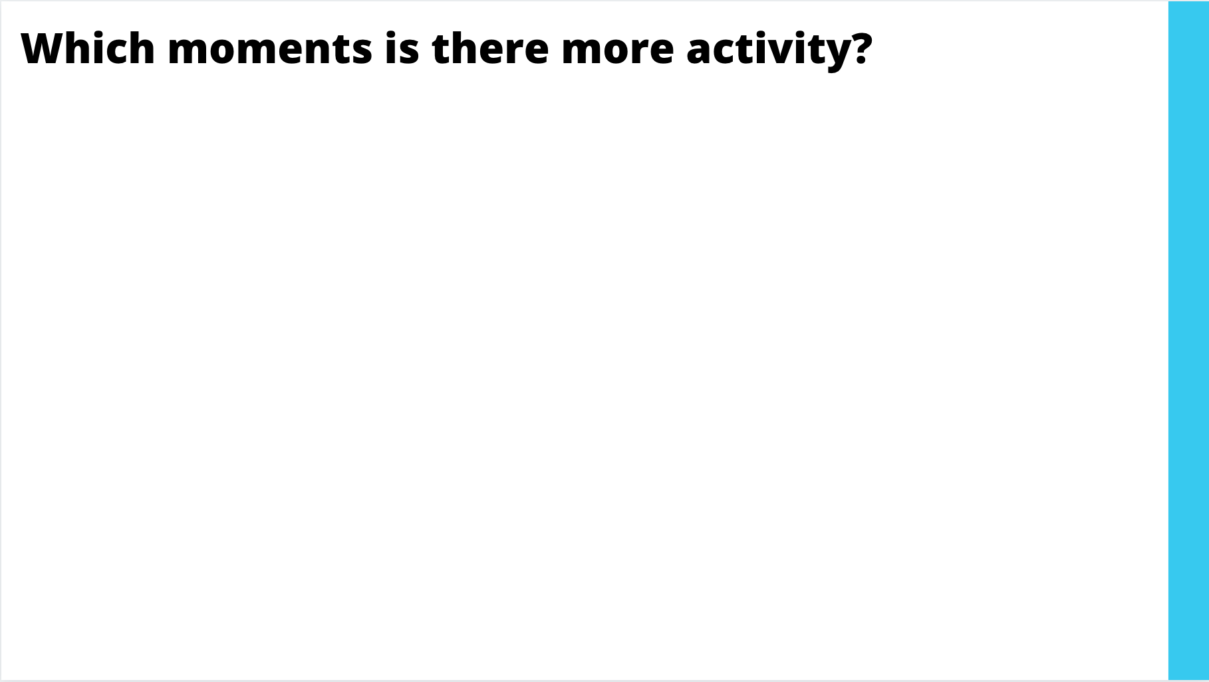
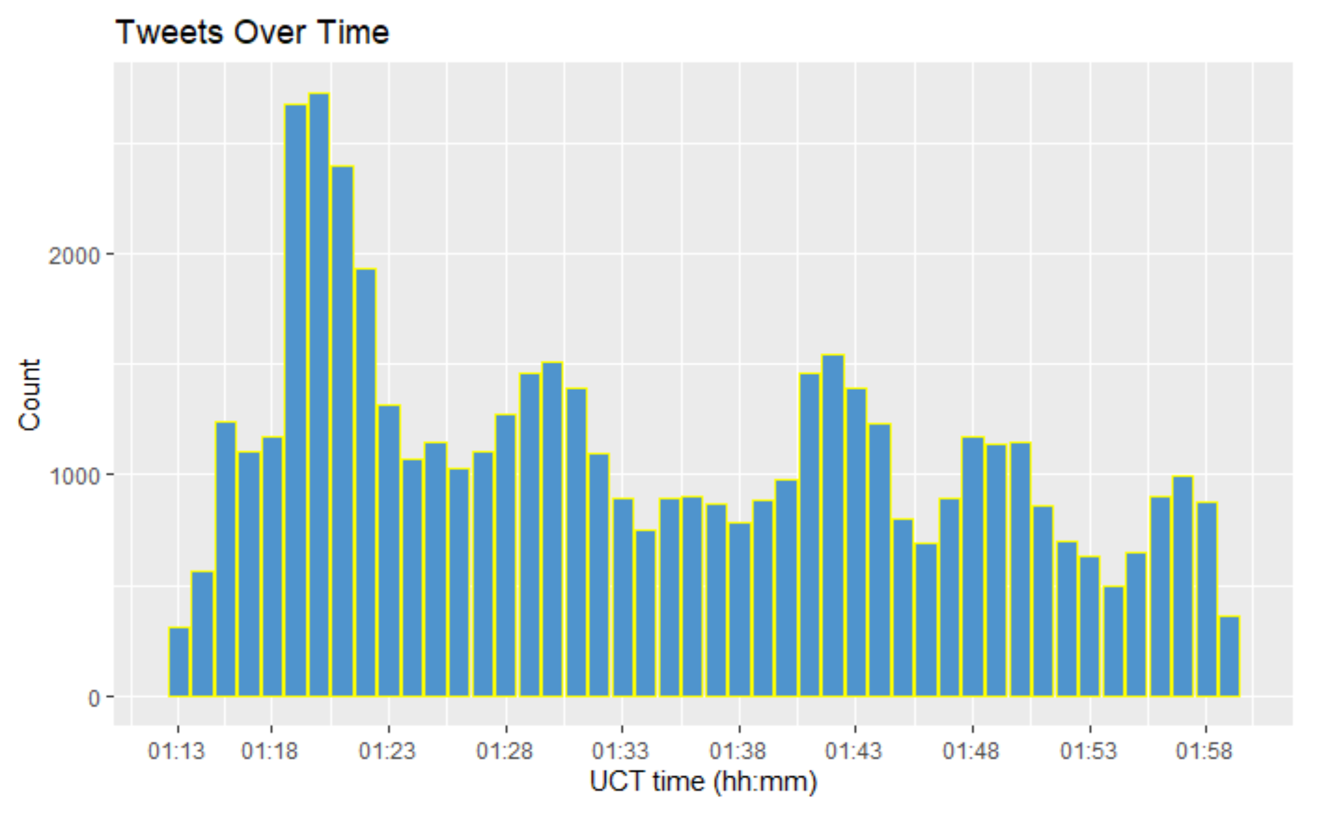
The number of tweets published increases sharply from 01:17 UCT (Universal Time Coordinated).

Slide 12

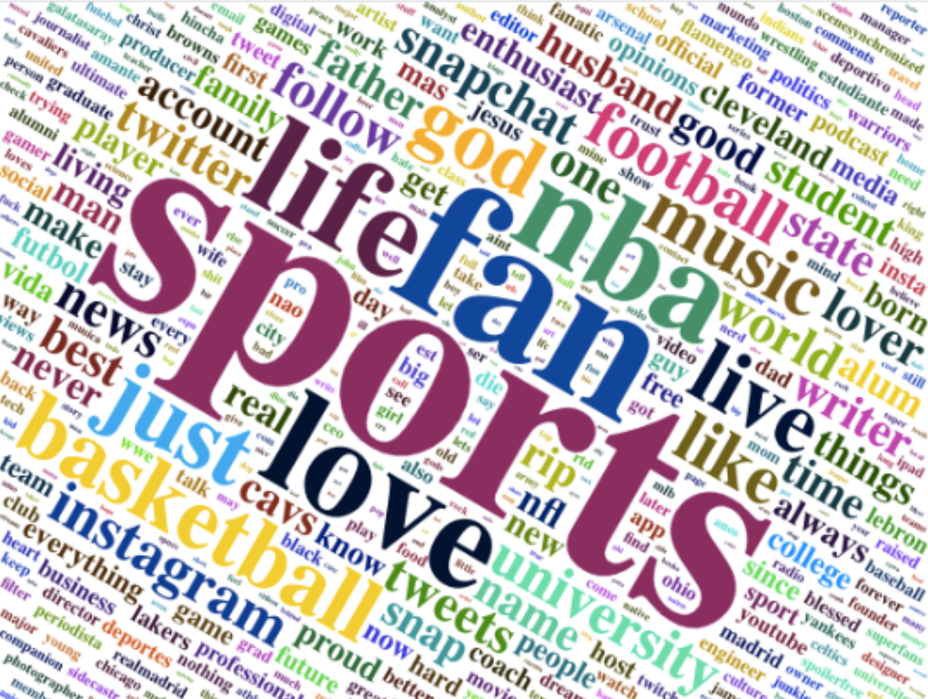


User Profile Description
WHO ARE THE USERS?
The captured tweets’ users mostly are sports lover/ huge fans of basketball

Slide 13
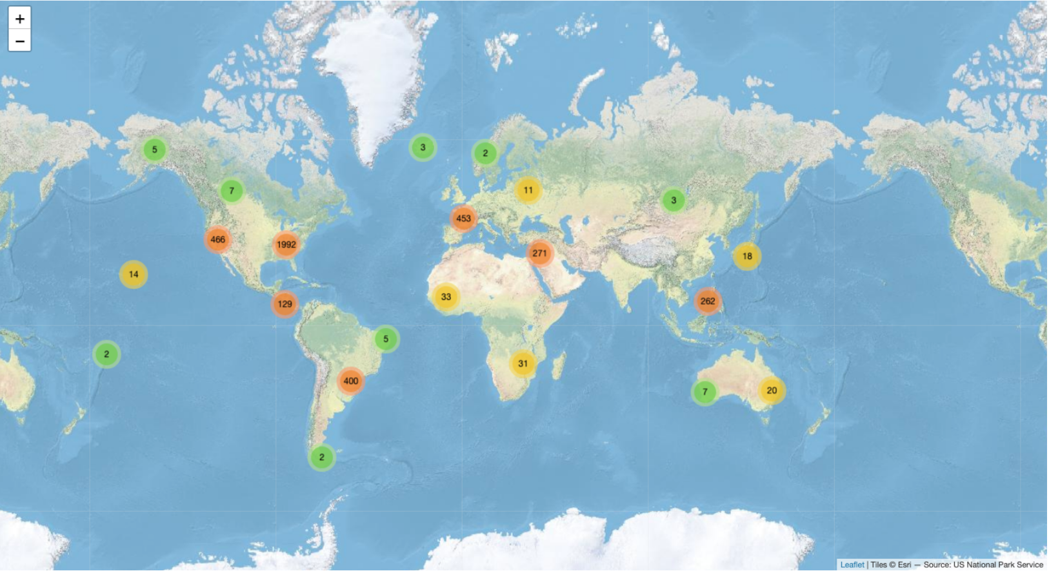
Twitter Users Geolocation

Slide 14
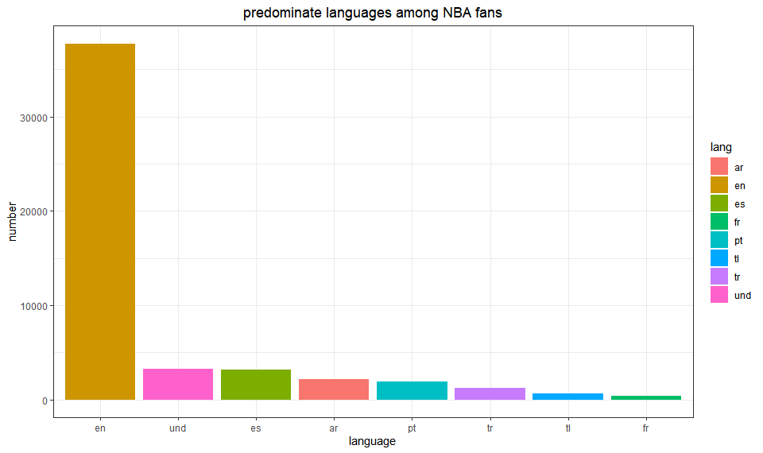
The Most Frequently Used Languages
The most frequently used languages from the captured Twitter text are
English and Spanish

Slide 15
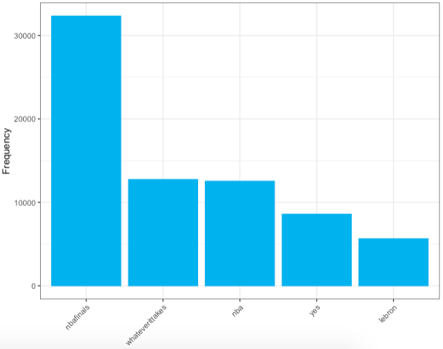
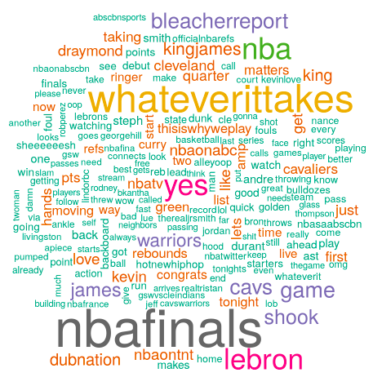
Word Frequency
The “nbafinals” is the most frequently used word followed by the winner of the game, “LeBron James”.

Slide 16
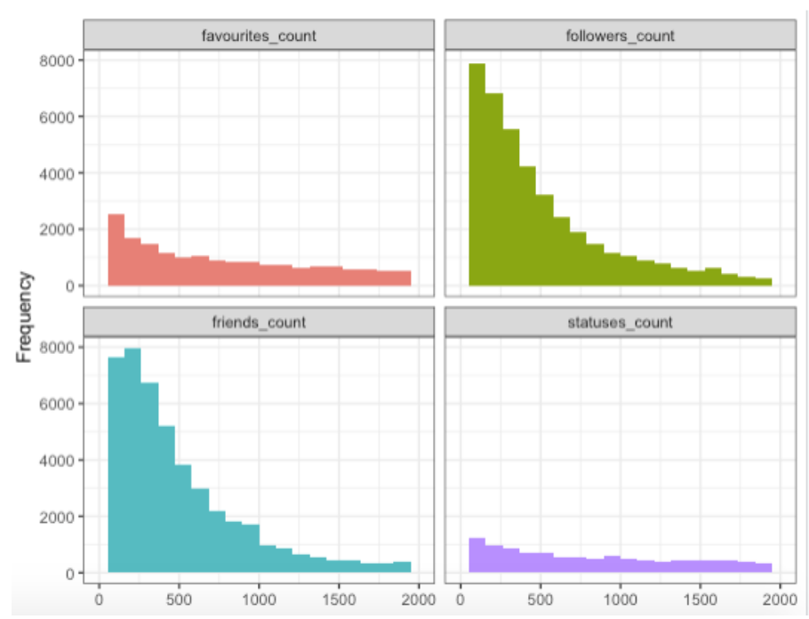
User Attributes
Friends_count:
The number of users this account is following
Followers_count:
The number of followers this user currently has
Favourites_count:
The number of Tweets this user has liked in the account’s lifetime
Statuses_count:
The number of Tweets (including retweets) issued by the user

Slide 17
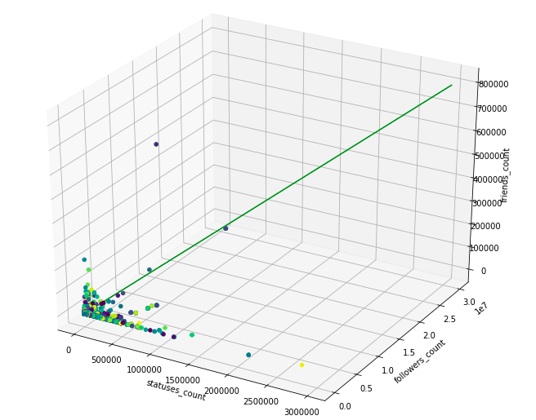
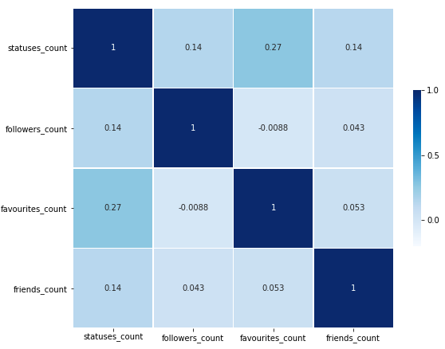
Correlation Between User Attributes
Correlation coefficient for each of user attribute is less than 0.5. Therefore, there seem to be no association between user attributes.

Slide 18
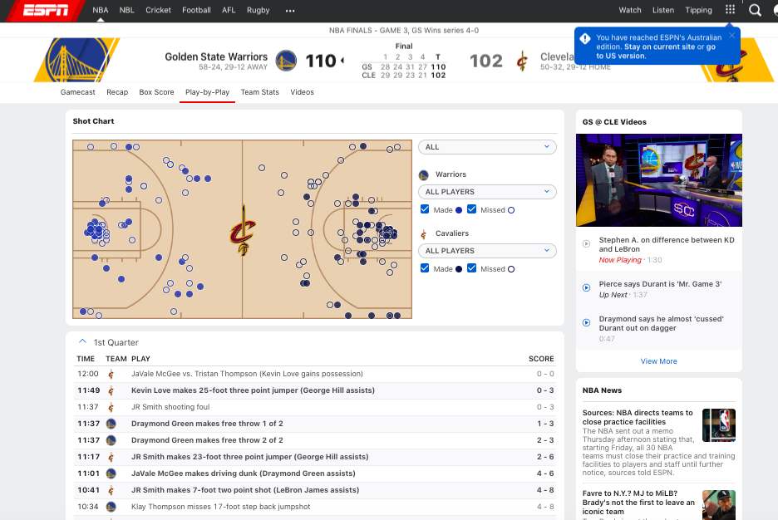

Additional Analysis After The Class Presentation
As per the feedback, we wanted to understand how the scores of the teams varied throughout the game.
We did Webscraping on the official ESPN website to get the minute by minute score data.
This analysis will help us understand whether we can link the trend in the game score to the trend in the number of tweets made during the game.

Slide 19


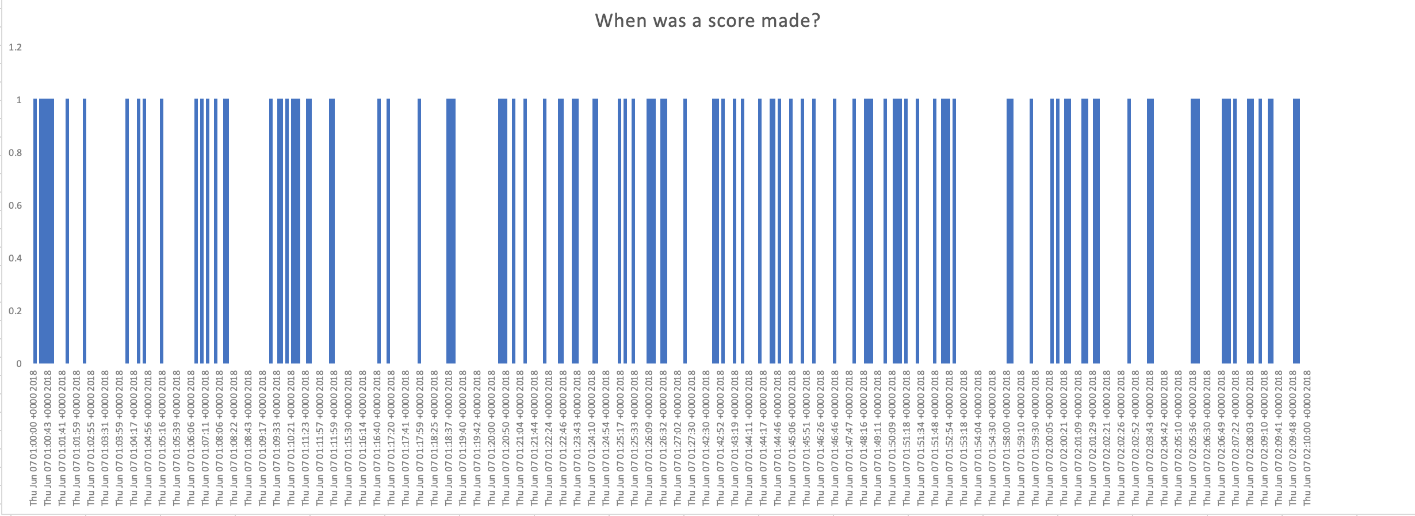
When Was a Score Made?
The bars showcase the exact time when a point was made, by either team
It can also be related with the graphs illustrating peaks in the number of tweets made during the game.
The thickness of the bar is proportional to the number of points scored in a continuous manner.

Slide 20
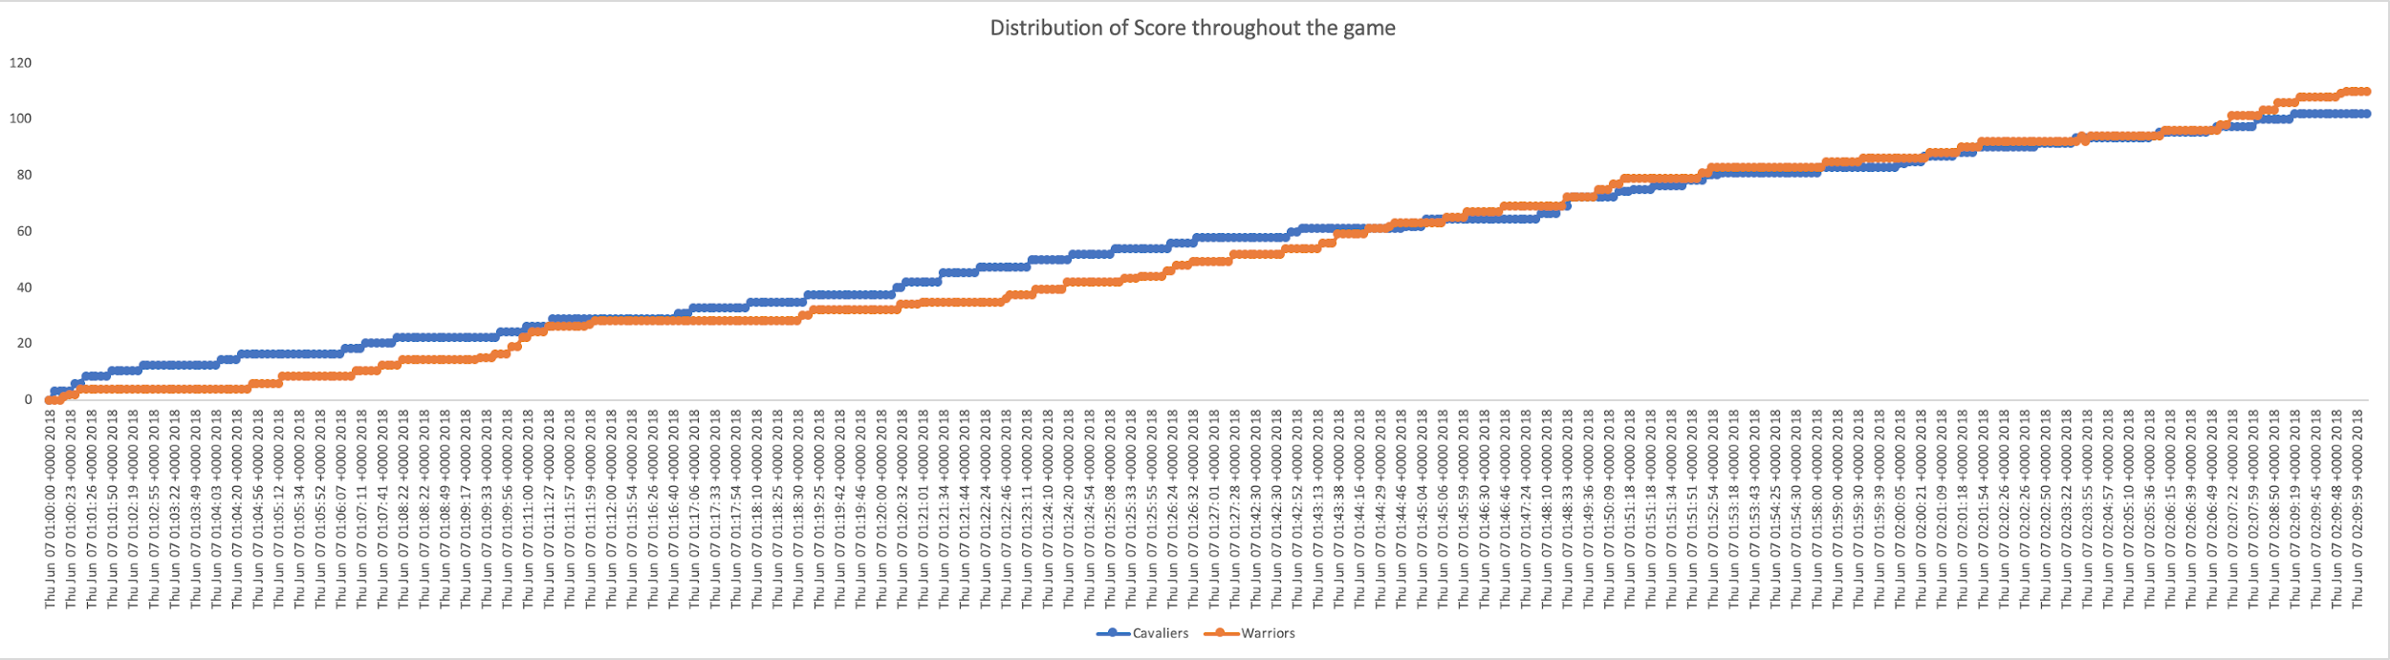
It Was Quite A Close Competition!
The graph showcases how the scores changed for each of the teams
The graph clearly demonstrates that it was a really interesting game where Cleveland was leading initially because of Lebron’s spectacular play but Golden State Warriors were able to catch up.
The yellow arrows indicate times when the number of tweets published as well as the sentiments timestamp graphs got the spikes. The spikes from the number of tweets published and the sentiments trends match with the score trend lines especially when Warriors getting close to lead the game or Cleveland got scores taken away from the Warriors where you may assume many emotions flowing around.

Slide 21
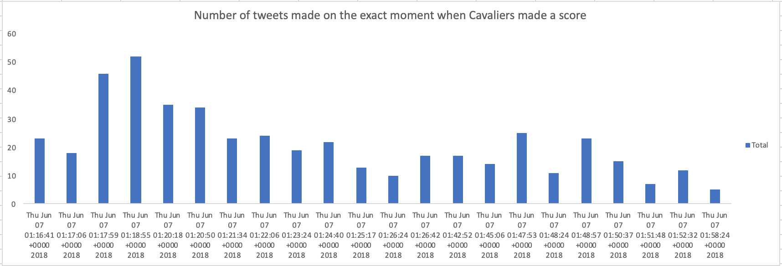
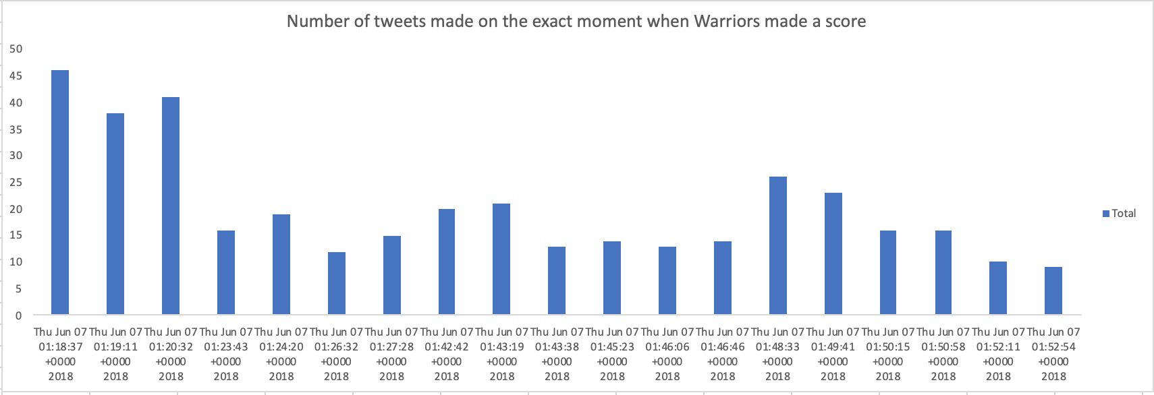
Tweets and Score
We first identified the time points at which a score was made by either of the team and then found the number of tweets that were made at that exact same time point.
These two graphs help to see how every second of the game had an impact on the tweets. For instance, at 1:17:59 UTC a score was made by Cavaliers and so the tweets were made at that time instantly and then at 1:18:37 UTC Warriors made a score and the tweets were made at that time.
So, these two graphs above show the epicentre of the flurry of tweets that followed after a few seconds.

Slide 22
Sentiment Analysis

Slide 23
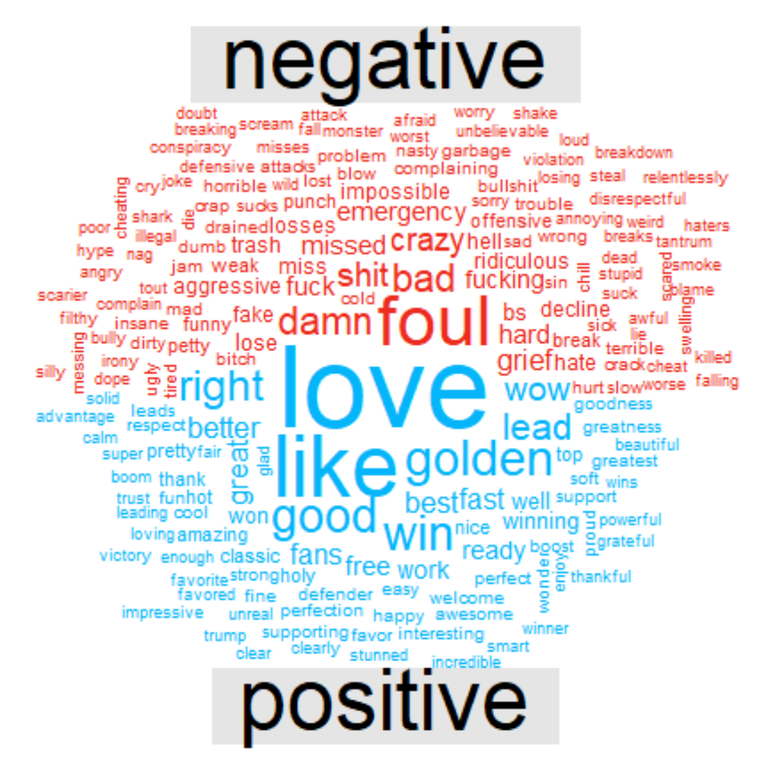
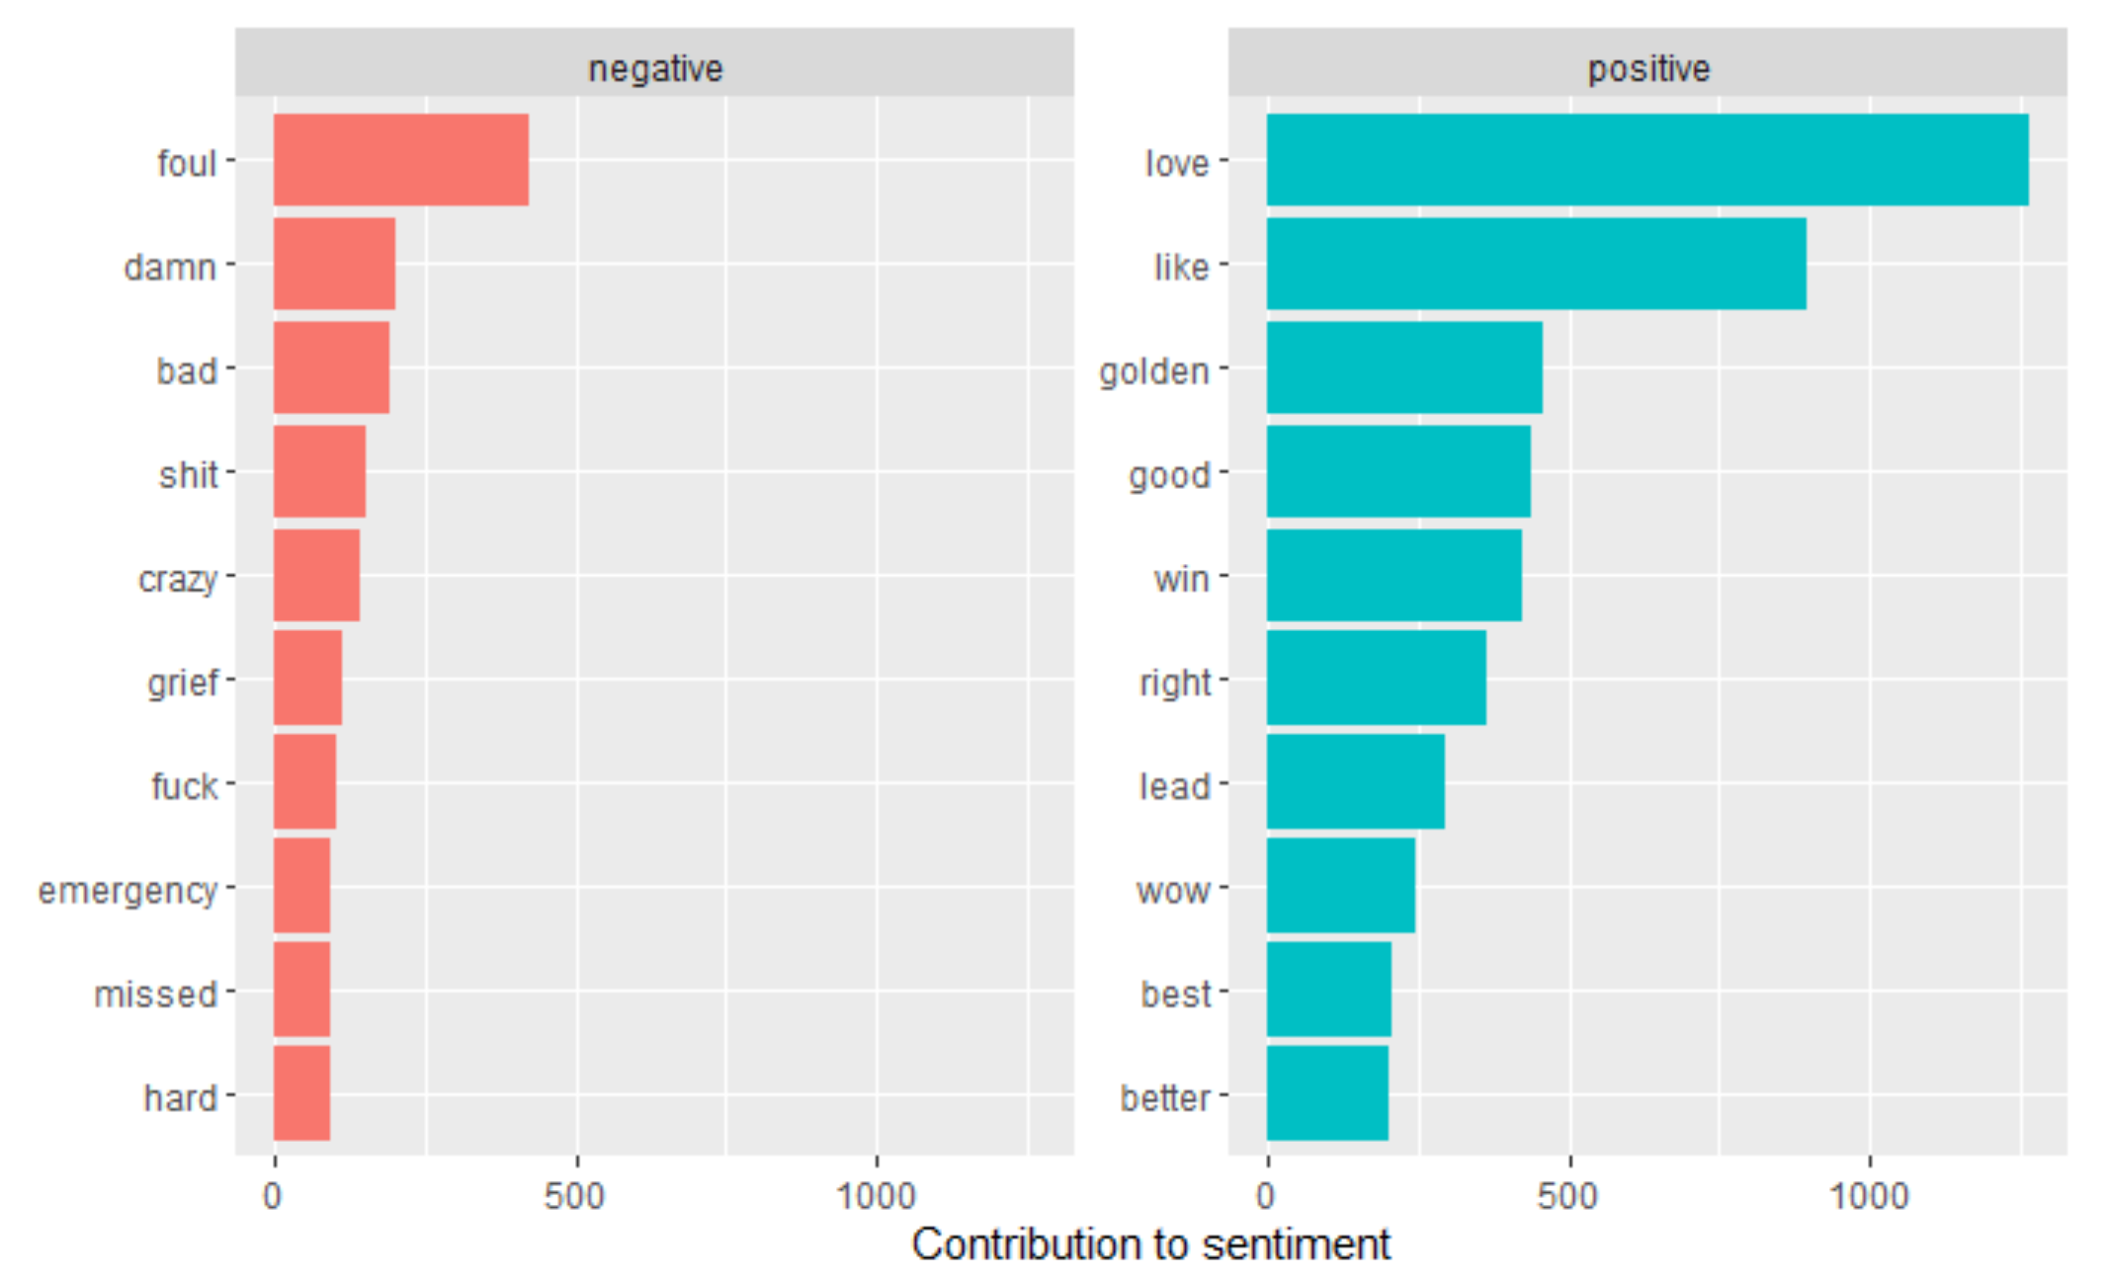
Categorizing Words Into Positive or Negative

Slide 24
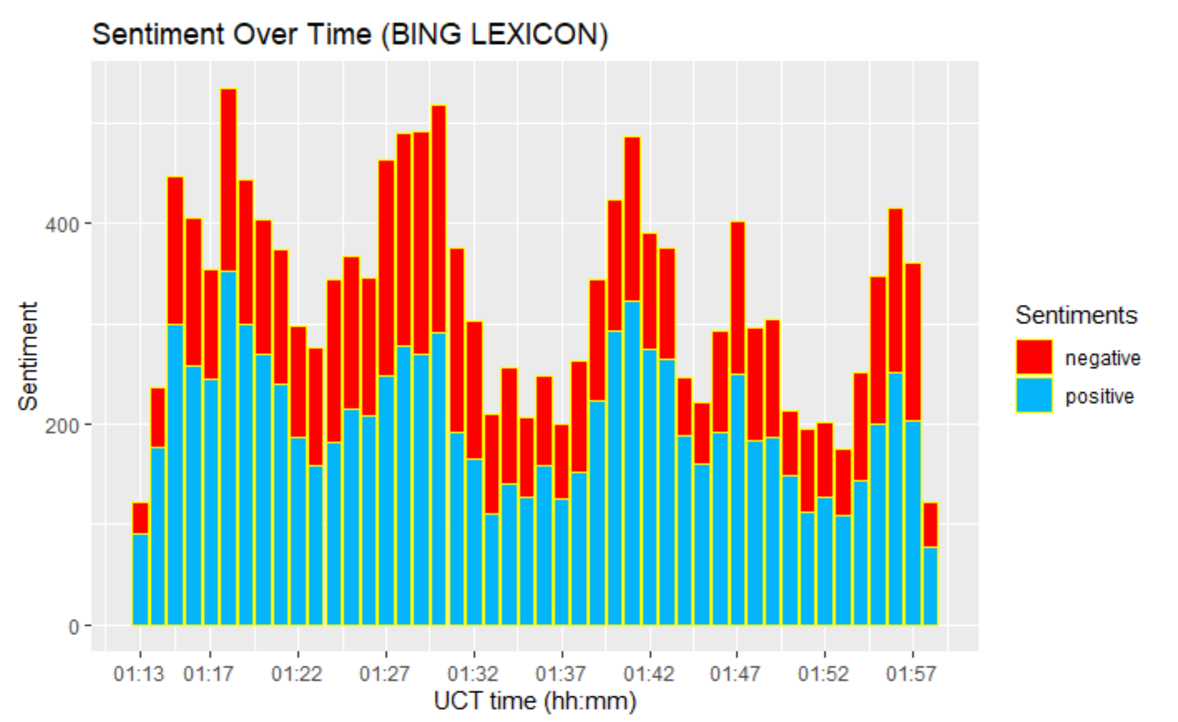
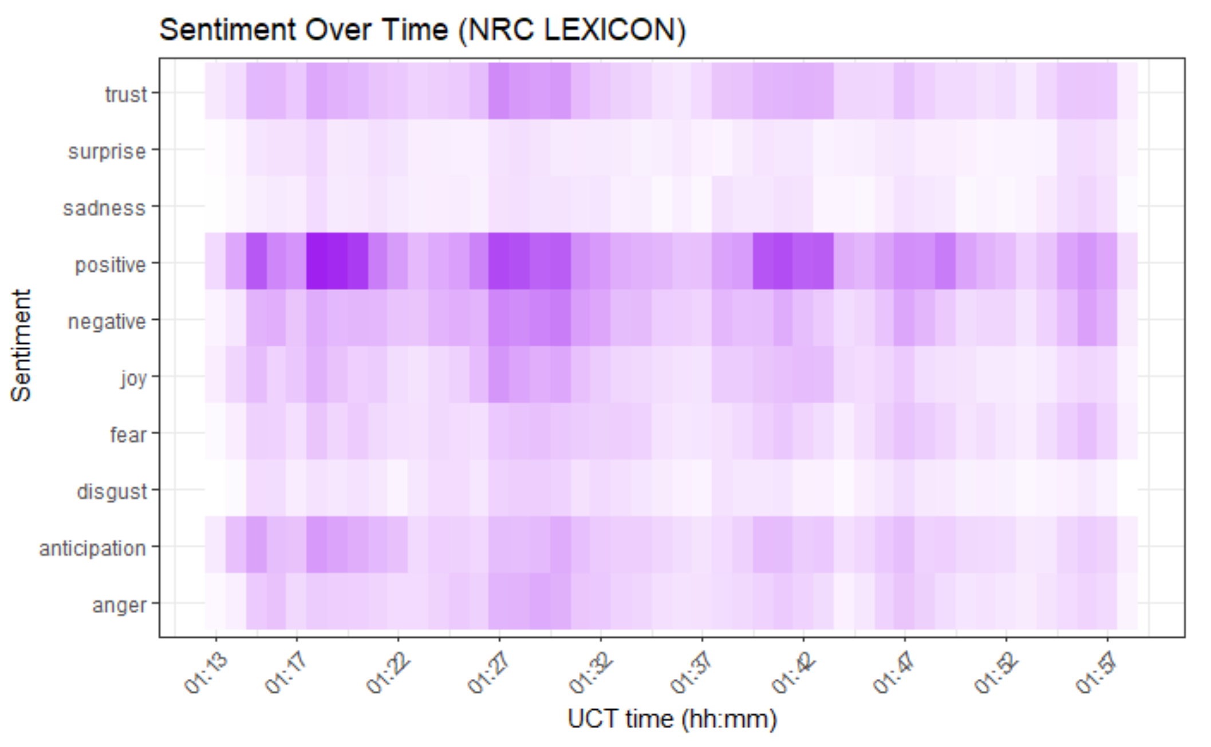
Sentiment Over TIME
There are 5 humps in the charts during the time periods.
The behaviors of positive sentiment and negative sentiment are in a similar trend - they go up and down in a similar way
We can also analyze the the pattern of change in sentiments at a much granular level. For instance, there are durations in time when sentiment of trust over-indexes on anger
Notes:
For instance, during the first hump, the positive sentiment would be more likely coming from trust and anticipation.

Slide 25
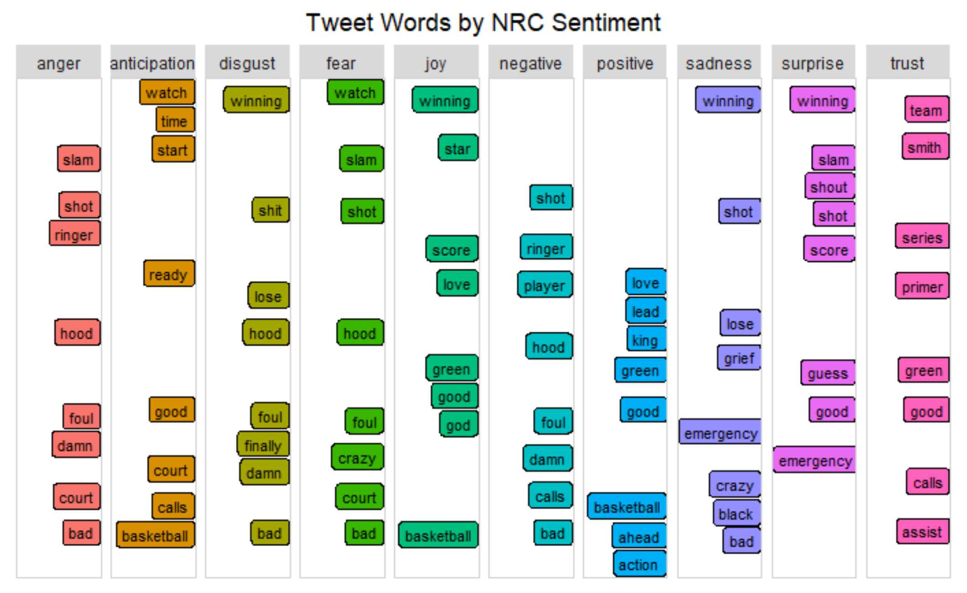
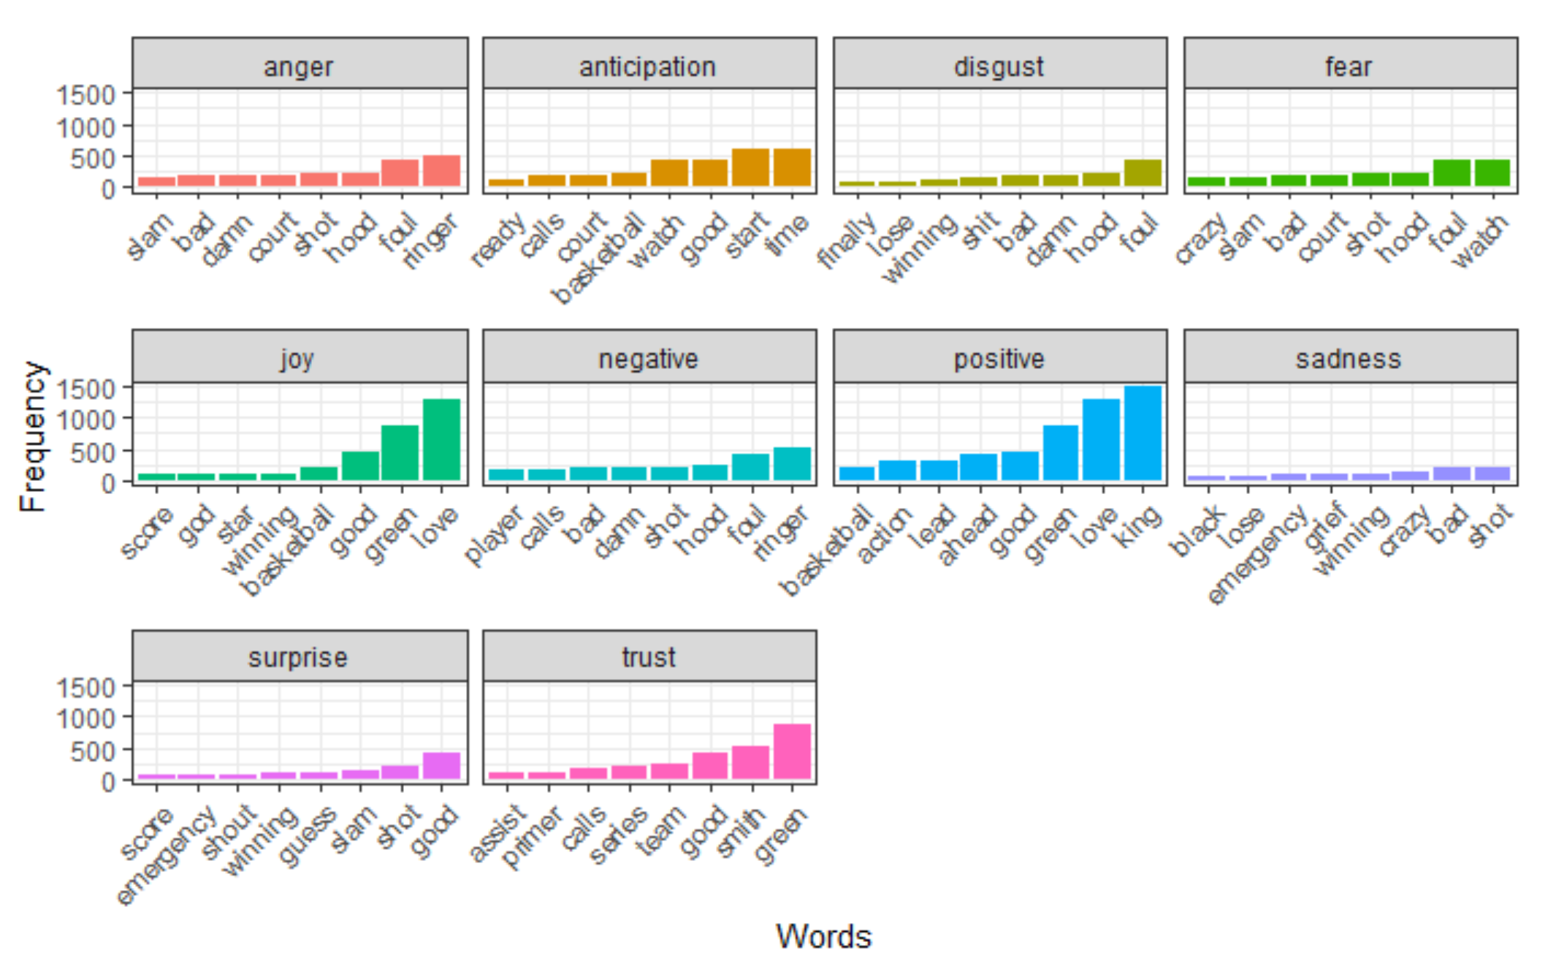
Get More Sentiments
Interestingly, “Winning” is not only assigned to positive sentiments, but also assigned to somewhat negative sentiments - for example “Disgust” , “ Sadness”

Slide 26
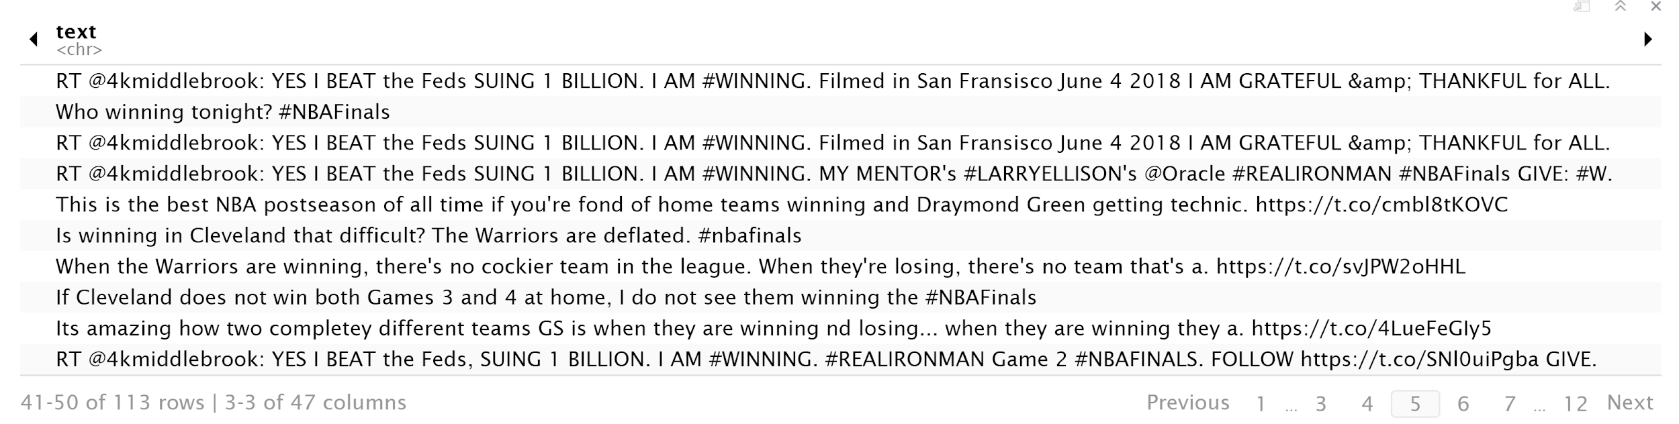
An Example “Winning” Used as Negative

Slide 27
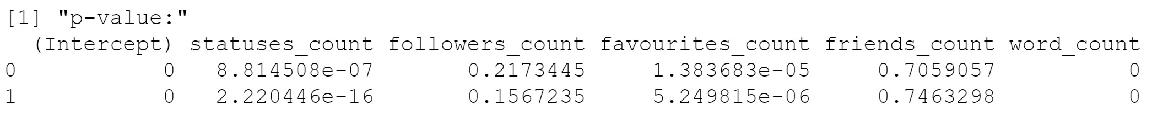
Multinomial Logistic Regression
According to the p-values, we found that statuses_count, Favourite_count and word_count significantly impact on the sentiment of each tweet.

Slide 28
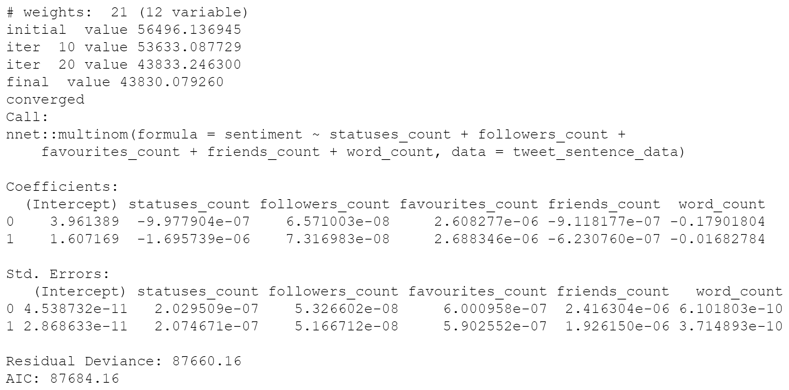
Interpretation
The variable statuses_count has the negative impact on the log odds of being neutral sentiment or being positive sentiment vs. negative sentiment.
The variable favourite_count has the positive impact on the log odds of being neutral sentiment or being positive sentiment vs. negative sentiment.
The variable word_count has the negative impact on the log odds of being neutral sentiment or being positive sentiment vs. negative sentiment.
Notes:
“which means the more words a sentence has the more likely it is that the sentiment is going to be negative than positive or neutral”

Slide 29
Social Network Analysis

Slide 30

Number of nodes = 52047
Lots of users were engaged on Twitter during the Final
SOCIAL NETWORK ANALYSIS
Number of edges = 31301
In this case, it represents the retweets on Twitter
Edge Density = 1.155514e-05
Edge Density is very low for 2 reasons:
Retweets are only outflows from Source to Target
Most users are “content consumers” who only retweet, rather than creating content for others to retweet
Reciprocity = 0
This proves our assumptions of the above bullet

Slide 31
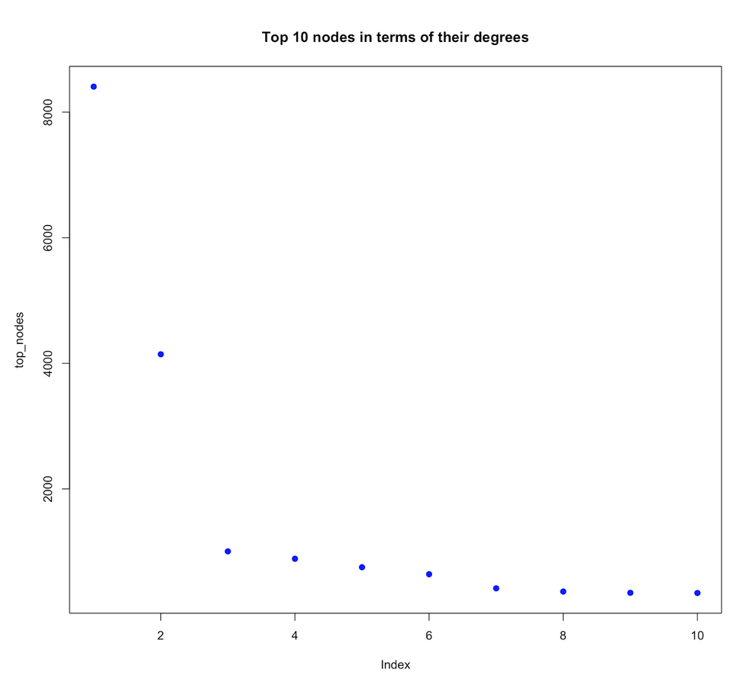
"NBA"
"BleacherReport"
Top 10 Nodes In Terms Of Their Degrees
"Arabic1_NBA"
"NBAonTNT"
"NBATV"
The max degree is 8406 which means one tweet got retweeted 8406 times.
Second most popular tweet was retweeted around 4000 times
"NBA"
"B24PT"
"warriors"
"BleacherReport"
"HotNewHipHop"

Slide 32
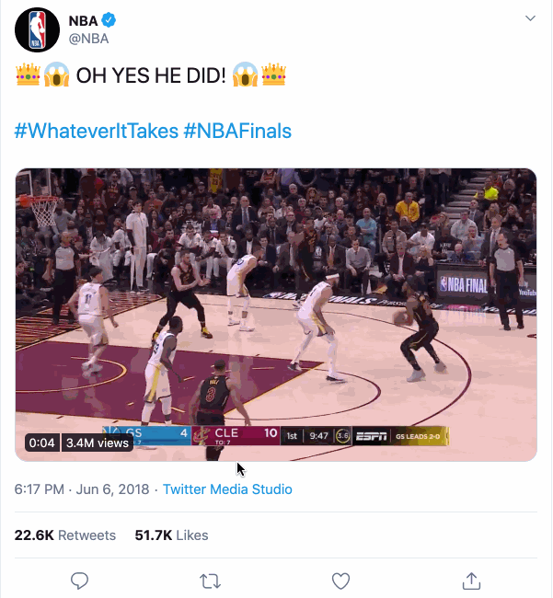


The Most Retweeted Tweet
= Node with the highest degree

Slide 33
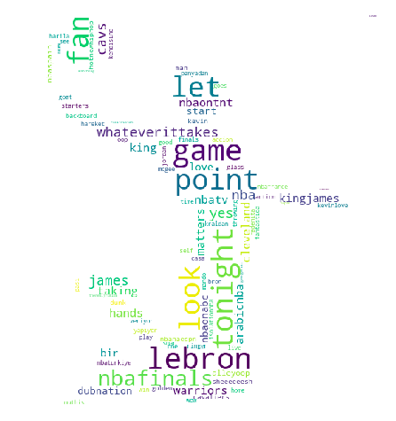
The star of the night “Lebron James” is the most popular words followed by the “point”, “game”, and ”fan”.
This shows the twitter users are on the spot and share the game experience in real-time.

Slide 34
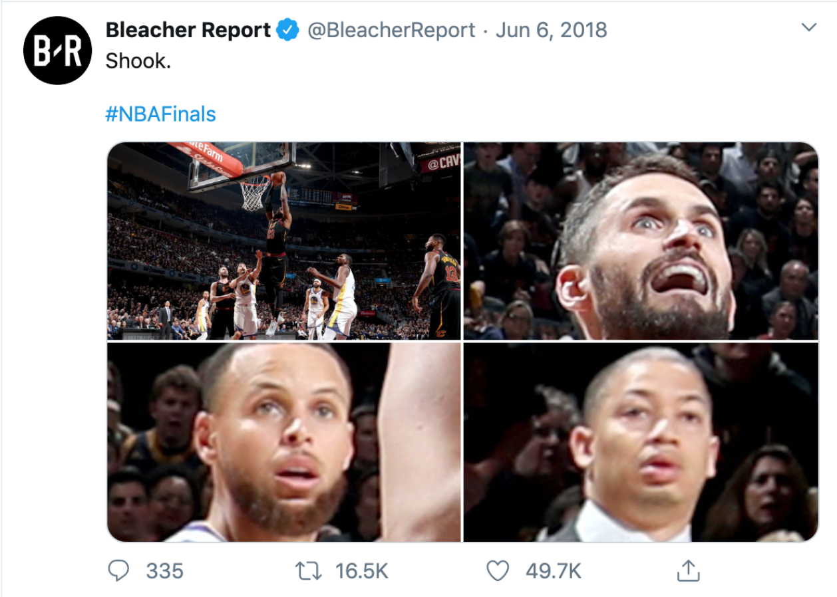
Node with the second highest number of retweets
#NBAFINALS

Slide 35

What's the limitation on using R?
The Node With The Highest Degree Using R

Slide 36


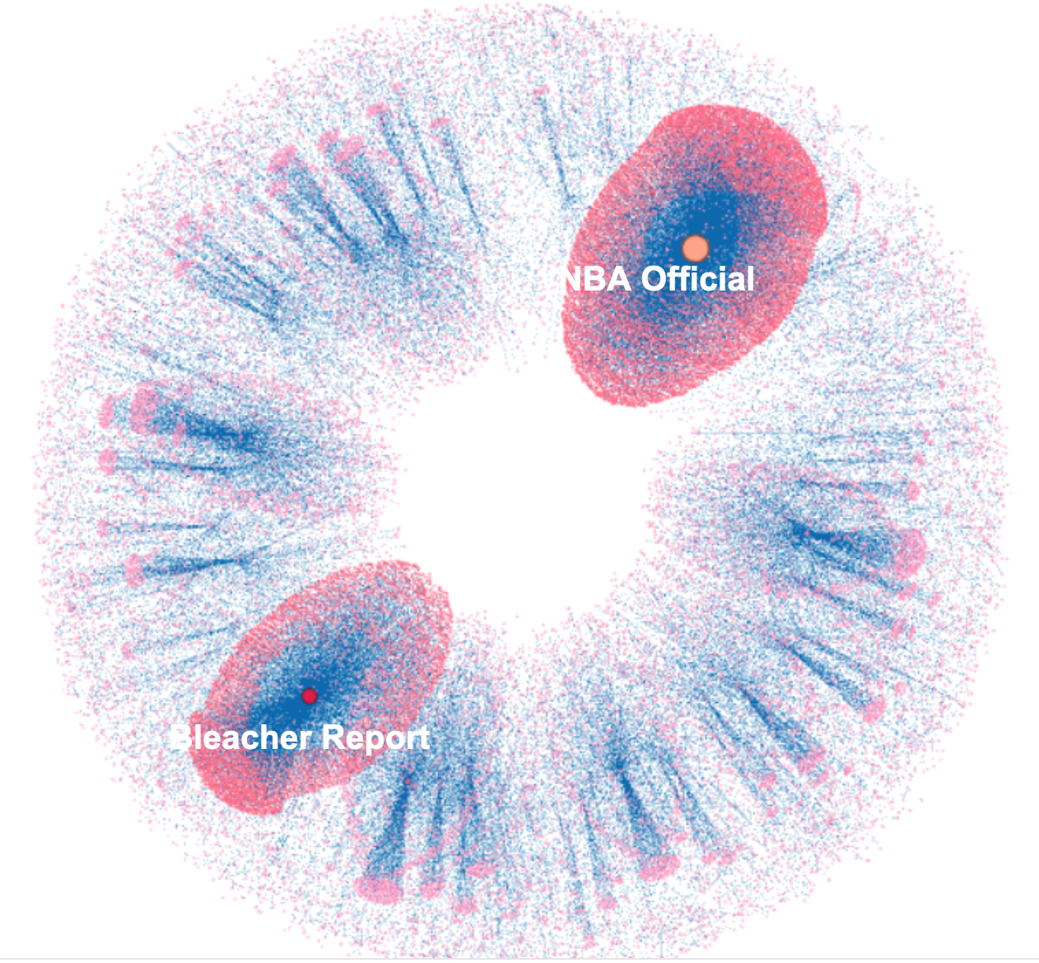

NBA Final Social Network Graph 1
Two “Stars” with Strong Gravity
"NBA Official" & "Bleacher Report"

Slide 37
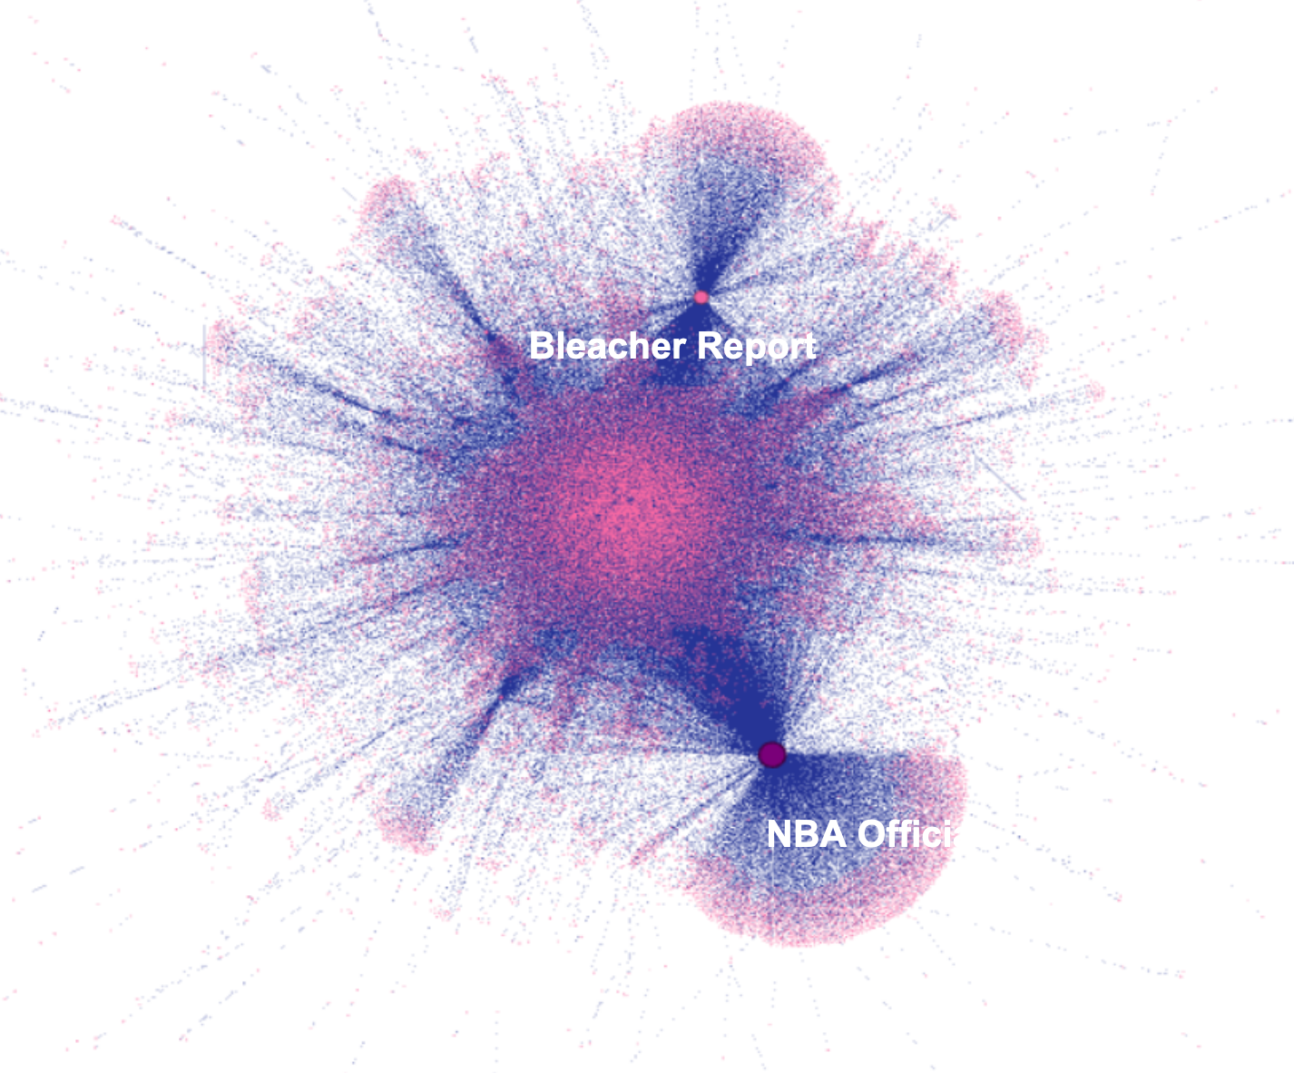
NBA Final Social Network Graph 2
Common Satellite Clusters for the Stars
Lots of users are common followers for both Bleacher Report and NBA Official
Twitter marketers can leverage network effect by creating content for multiple accounts for same group of users

Slide 38
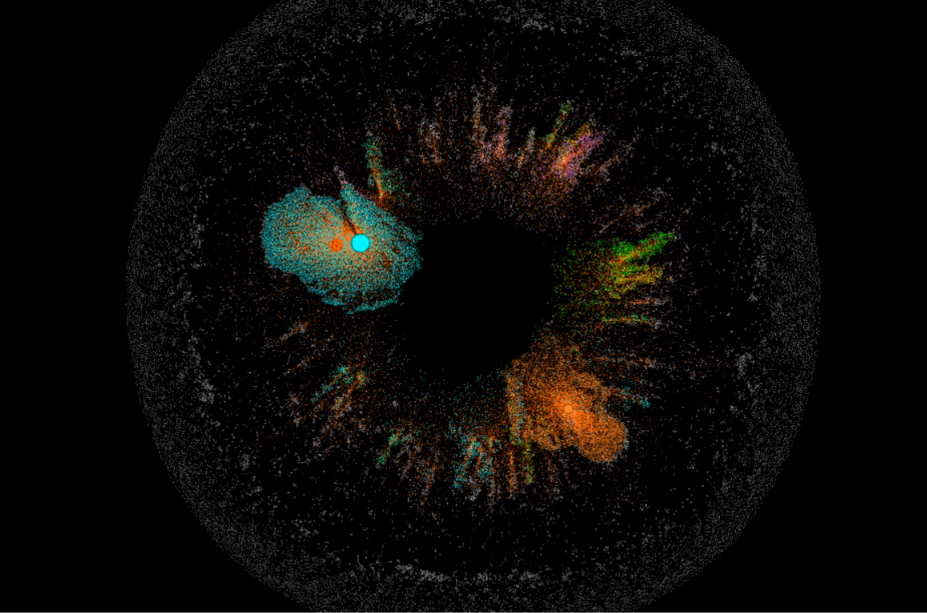
Holistic View With Color Coded Clusters

Slide 39
Takeaways

Slide 40
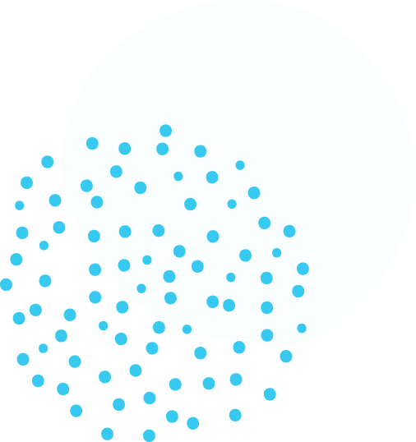

Takeaways
Major sports games can have huge impact on Twitter user community and interaction between users
Marketing agencies can tap in emotions/sentiments/behaviour and perhaps start a hashtag trend with the game especially when twitter is blowing up because something important happened on the game.
Analyzing major account’s characteristics (i.e. HotNewHipHop) can give companies information about their audiences’ psychographics

Slide 41
Thank You!
Details can be found in our final report

